Slide 1
POST-SOPHOMORE FELLOWSHIP PROGRAM IN PATHOLOGY AND SCHOLARLY PURSUIT
University of Pennsylvania Medical Center
Department of Pathology & Laboratory Medicine
Cindy McGrath, MD
Professor, Academic Clinician
Director of Student Fellowship in Pathology

Slide 2
Student Fellowship Program in Pathology
Unique work-study experience
Experience and education is beneficial to ANY future career
Year long program includes rotations in Anatomic and/or Clinical Pathology in which the student fellow takes on clinical responsibilities comparable to that of a first year resident PGY-1 for 9 months, in addition to:
Dedicated research project of choice for 3 months with guidance and mentoring provided—typically results in national meeting presentation and publication
Fellowship is tailored to the individual’s interests with appropriate rotations and electives
Fulfills Scholarly Pursuit Requirement
Stipend: $27,000 + Student Fees + Insurance (apply towards following year’s tuition or as a monthly stipend)
Application (Sept thru Jan preferred for upcoming start June/July), CV, references, interview (2 positions)
cindy.mcgrath@pennmedicine.upenn.edu
Recent student fellows: Travis Hoover, Caroline Kim, Joseph Kim, Mike Baer, Esther Baranov, Clayton Marcinak

Slide 3
Student Fellowship Rotations
Anatomic Pathology
Surgical Pathology
Cytopathology
Medical Pathology or Autopsy
Clinical Pathology or Laboratory Medicine
Transfusion Medicine
Hematopathology
Coagulation
Chemistry
Immunology
Microbiology
Molecular Pathology/ Center for Personalized Diagnostics
√
√
√
√
√
Medical Examiner’s Office
Dermatopathology
Pediatric Pathology
GI Pathology
√
√

Slide 4
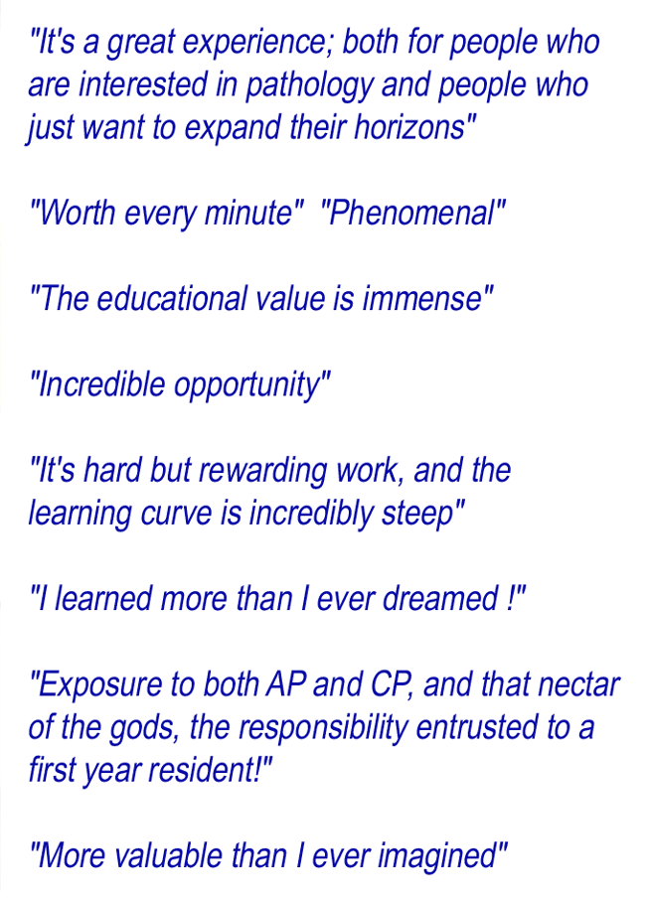
Student Fellowship Program in Pathology

